Slide 1
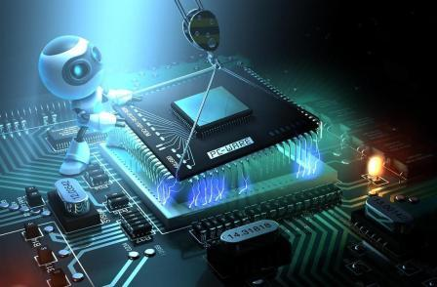
Real-Time Embedded System
/

Slide 2
Contents
What is a Real Time (RT)?
What is an Embedded System (ES)?
Real Time Embedded System (RTES).
Requirements for RTES
Characteristics of Embedded Systems
Embedded system components Hardware and Software
examples of Embedded operating systems
Examples of RTES in Past, Present, and Future.

Slide 3
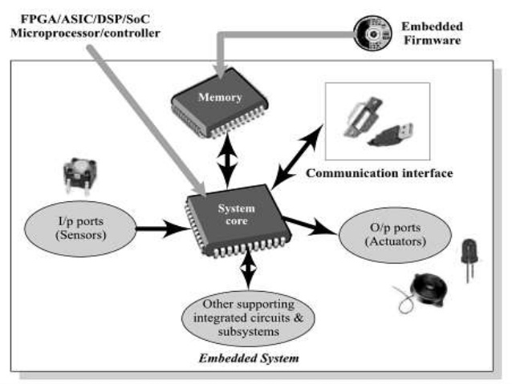
What is a Real Time (RT)?
Real-time systems can be defined as those systems that respond to external events in a timely fashion. The response time is guaranteed.
needs timely computation
deadlines, jitters, periodicity
temporal dependency

Slide 4
What is a Real Time (RT)?
Is defined as a system in which the time where the outputs are produced is significant (within specified bounds or deadlines)
RTS
Actuator Outputs
Sensor Data
Commands
Displays
Correctness depends on output values and the time at which
the inputs are processed and the outputs are produced

Slide 5
Real Time (RT) System
Real-Time Systems can be Hard Real-Time systems or Soft Real-Time systems
In Hard Real-Time systems outputs must be produced within the specified deadlines or a system failure will occur (Examples include: Flight Control systems, Air Traffic Control systems, Robots, Automotive Control Systems,..)
In Soft Real-Time Systems, deadlines can be occasionally missed ( Examples include: communications systems using time out protocols, ATMs, Air line Reservation Systems, Process Control Systems designed to tolerate delays)

Slide 6
What is an Embedded System (ES)?
An embedded system is a system that has software embedded into computer-hardware, which makes a system dedicated for an application (s) or specific part of an application or product or part of a larger system
“An embedded system is one that has a dedicated purpose software embedded in a computer hardware.”
“It is any device that includes a programmable computer but is not itself intended to be a general purpose computer.” – Wayne Wolf.

Slide 7
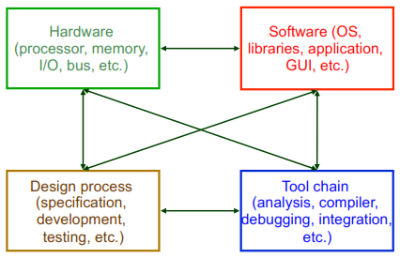
Embedded Systems

Slide 8
Embedded Systems
are everywhere
How many embedded processors in your home?
What are they?
40-50 estimated in 1999.
Hardware (chips) + Software (program)
CPU processor (ARM, PowerPC, Xscale/SA, 68K)
Memory (256MB or more)
Input/output interfaces (parallel and serial ports)

Slide 9
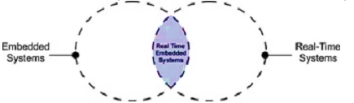
Real-time Embedded Systems (RTES)
A good way to understand the relationship between real-time systems and embedded systems is to view them as two intersecting circles.

Slide 10
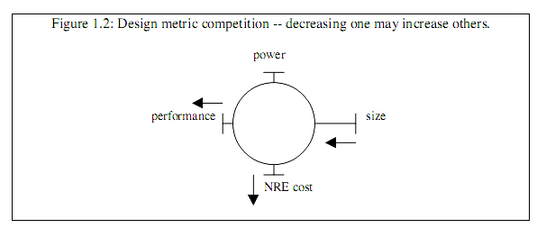
Requirements for RTES
Environmental – size, power (heat), weight, and
radiation-hardened
Performance –responsive, predictable (fast?)
Economic – low cost and time-to-market
Consequence – safety, faulty-tolerance, security
Smaller, cheaper, better, and faster

Slide 11
Characteristics of Embedded Systems
Reactive and real-time: Many embedded systems must continually react to changes in the system’s environment, and must compute certain results in real time without delay.
For example, a car have different tasks for controls such as for the following:
Driving Gears
Windows
Temperature
Door-lock/ Theft-lock-alarm
Brakes/ Accelerator
Air-Bag, Accident/ Emergency

Slide 12
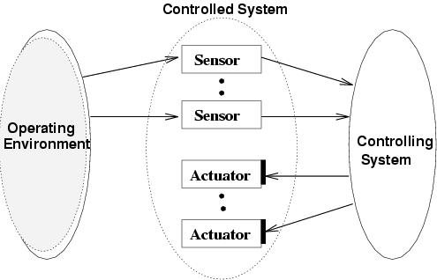
A typical real-time embedded system

Slide 13
Car example
Mission: Reaching the destination safely.
Controlled System: Car.
Operating environment: Road conditions.
Controlling System
- Human driver: Sensors - Eyes and Ears of the driver.
- Computer: Sensors - Cameras, Infrared receiver, and Laser telemeter.
Controls: Accelerator, Steering wheel, Break-pedal.
Actuators: Wheels, Engines, and Brakes.

Slide 14
Car example (contd)
Critical tasks: Steering and breaking.
Non-critical tasks: Turning on radio.
Cost of fulfilling the mission → Efficient solution.
Reliability of the driver → Fault-tolerance needs to be considered.

Slide 15
Characteristics of Embedded Systems(Con.)
Digital camera illustrates some of the embedded system characteristics described above.
First, it performs a single function repeatedly.
The system always acts as a digital camera
Second, it is tightly constrained.
The system must be low cost since consumers must be able to afford such a camera.

Slide 16
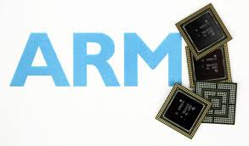
Embedded system components Hardware and Software
To meet those constraints, Hardware/software codesign is the simultaneous design of the hardware and software components of a digital system.
hardware Components
The hardware components are:
Processor (e.g ARM)
Memory
peripherals

Slide 17
software components (embedded operating system)
It seems like you're discussing the essential features and considerations of real-time and embedded operating systems (OSs) based on the images you mentioned. Here are the key points:
Configurability: Embedded OSs need to be highly configurable. This means they can be tailored to specific hardware and application requirements by adjusting features and removing unnecessary functions. This optimization is often done at the linker level or through advanced compile-time evaluations and optimizations.

Slide 18
software components (embedded operating system)
Dynamic to Static Data: In some cases, dynamic data (which requires runtime management) can be replaced with static data. This reduces the overhead of memory management and can improve efficiency in embedded systems where memory resources are typically limited.
Peripheral Variety: Embedded systems utilize a wide range of peripheral devices. Unlike general-purpose computers, they may not have traditional components like hard disks, keyboards, screens, or mice. Embedded OSs need to manage and interact with these diverse peripherals efficiently.

Slide 19
software components (embedded operating system)
Protection Mechanisms: Unlike desktop or server OSs, embedded systems often operate in a controlled environment with a single purpose. This reduces the need for extensive protection mechanisms against untested programs or external threats, although ensuring reliability and safety remains critical.
Software Components: Embedded operating systems consist of specialized software components designed to manage hardware resources, schedule tasks, handle I/O operations efficiently, and provide real-time capabilities as needed by the application.

Slide 20
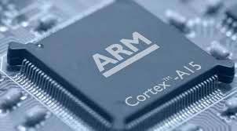


examples of Embedded operating systems
The ARM architecture is supported by a large number of embedded and real-time operating systems, including Android, Linux, Microsoft Windows System, Symbian. The following are some of the embedded OSs:
Android: is a Linux-based operating system for mobile devices such as smartphones and tablet computers. It is developed by the Open Handset Alliance, led by Google, and other companies.
Linux: Almost everyone in the computer business knows the history of Linux - started in 1991 by Linus Torvalds as a simple hobby project, grown-up to a full-featured UNIX-like operating system.

Slide 21
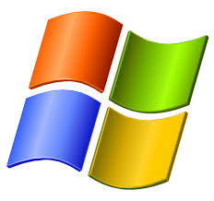
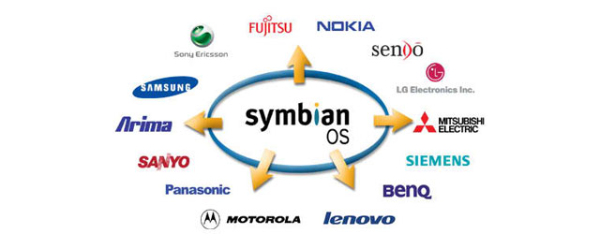
examples of Embedded operating systems (Con.)
Microsoft Windows Systems: At present, there are two operating systems for embedded systems from Microsoft – Windows CE and Windows XP Embedded.
Windows CE (WinCE) is an operating system for minimalistic computers and embedded systems.
Windows XP Embedded, or XPe, is a modularised variant of Microsoft Windows XP Professional.
Symbian: OS is the successor of 32-bit EPOC Platform from Psion. Symbian is currently owned by Ericsson (15.6%), Nokia (47.9%), Panasonic (10.5%), Samsung (4.5%), Siemens AG (8.4%), and Sony Ericsson (13.1%). All of the owners are (or were) manufacturers of mobile phones.

Slide 22
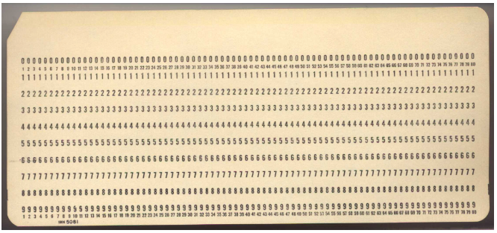
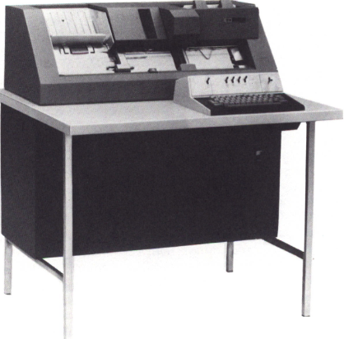
Examples In Past

Slide 23
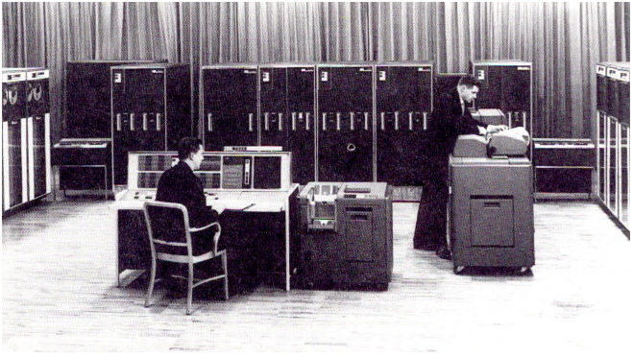
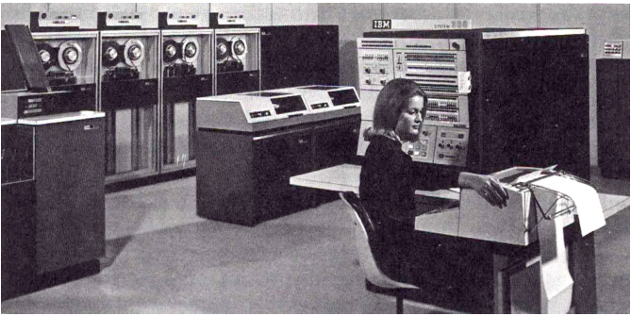
Examples In Past (Con.)

Slide 24
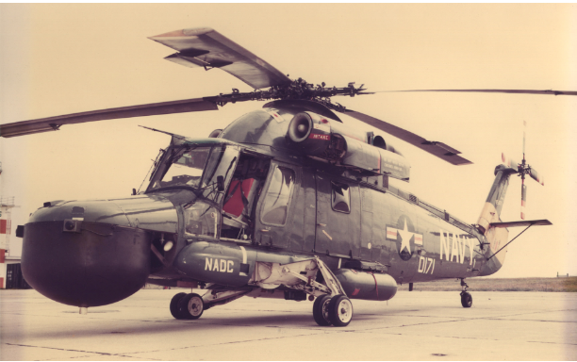
LAMPS Radar Test

Slide 25
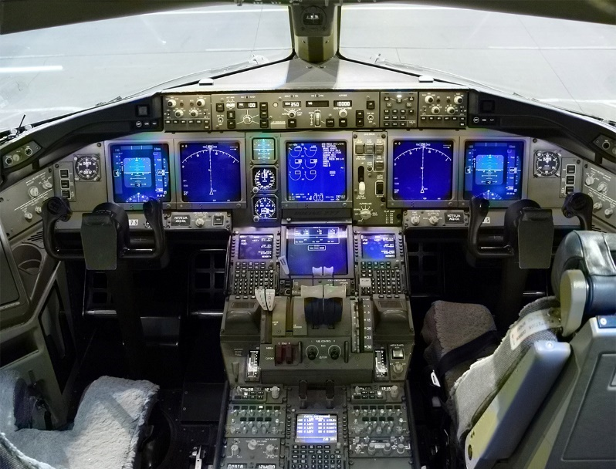
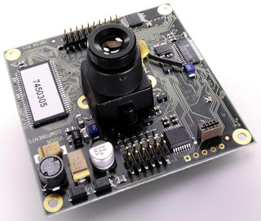
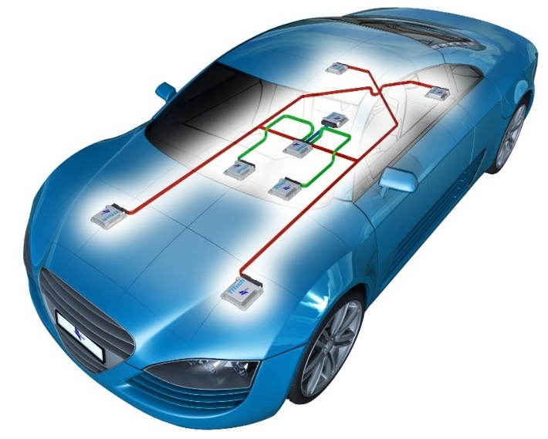
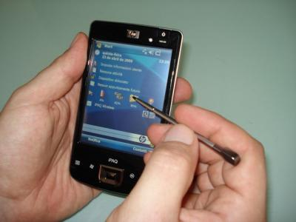
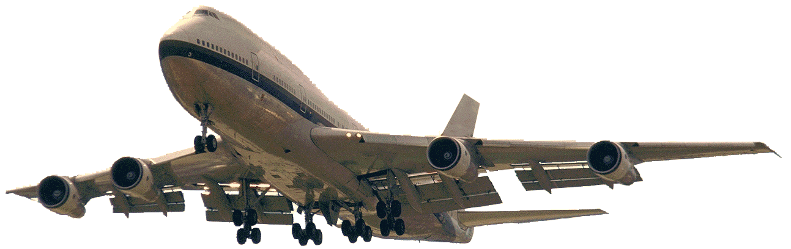
Examples in Present and Future

Slide 26
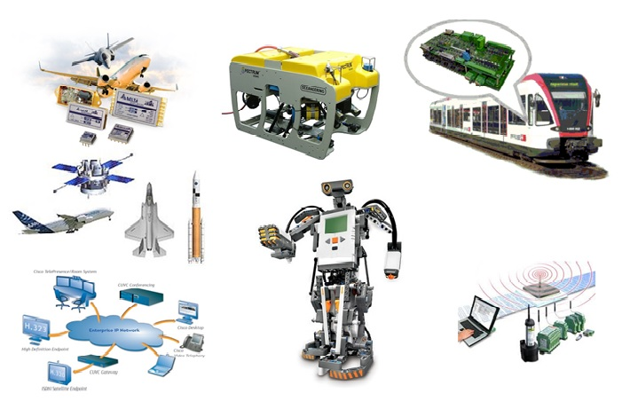
Examples in Present and Future

Slide 27
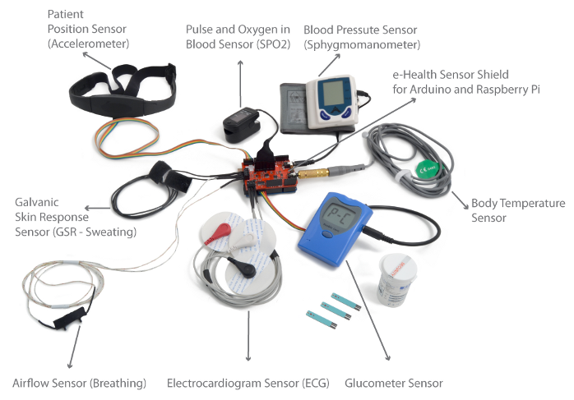
Examples in Present and Future

Slide 28
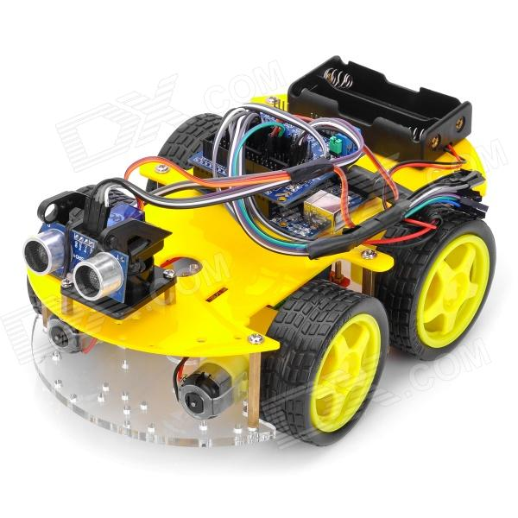
Examples in Present and Future

Slide 29
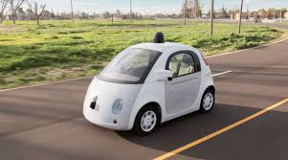
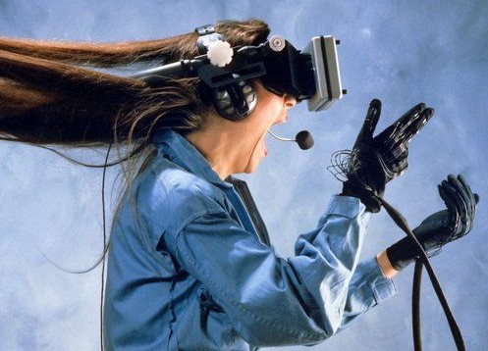
Examples in Present and Future

Slide 30
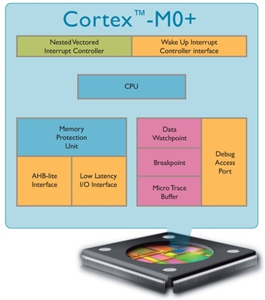
Hardware Overview
The ARM Processor is the most energy efficient ARM processor available.
It builds on the very successful Cortex-M0 processor, retaining full instruction set and tool compatibility.
While further reducing energy consumption and increasing performance.

Slide 31

Thanks

